Slide 1
Mobile Bay National Estuary Program
Finance Committee Meeting
Tuesday, August 23, 2022, 10:00 am – 11:00am
Welcome
Review/Approval of Minutes- NA
Infrastructure Plan Presentation for review/approval
Long Term Planning conversation
Role of Finance Committee in CCMP Development
Local Memorandum of Agreement
Change of Name

Slide 2
BIL Infrastructure 5-Year Framework/Two Year Action Plan
“Tackle the Climate Crisis” by reducing emissions that cause climate change and accelerating resilience and adaptation to climate change impacts; and
“Take Decisive Action to Advance Environmental Justice and Civil Rights” by promoting EJ and protecting civil rights at the federal, state, and local levels.
EPA Priorities for NEPs in their use of BIL Funding

Slide 3
BIL Infrastructure 5-Year Framework/Two Year Action Plan
How will BIL Dollars be used to transform environmental management along the Alabama Coast?
Environmental monitoring to track change to better understand and address pollutant loading and contamination across our two coastal counties;
Shoreline stabilization and resilience to strengthen our first line of defense against rising seas and greater intensity of storms resulting from climate change; and
Green infrastructure in underserved areas to counter chronic flooding and other stormwater management challenges facing disadvantaged communities.

Slide 4
FIVE YEAR BIL Framework
 |  | Year 1 | Year 2 | Year 3 | Year 4 | Year 5 | Total
CCMP | BIL Five-Year Strategy | Budget Amount
EST-1 | Coastal Environmental Monitoring Program | 125,241 | 50,000 | 100,000 | 100,000 | 100,000 | 475,241
 | Bay Monitoring | 75,241 |  |  |  |  | 75,241
 | Watershed Monitoring | 50,000 | 50,000 | 100,000 | 100,000 | 100,000 | 400,000
ERP-3 | Resilient Shorelines Program | 272,241 | 297,482 | 348,659 | 348,659 | 350,118 | 1,617,159
 | Management Plan | 225,000 |  |  |  |  | 225,000
 | 50% Cost share program |  | 250,241 | 300,000 | 300,000 | 300,000 | 1,150,241
 | Project Delivery | 47,241 | 47,241 | 48,659 | 48,659 | 50,118 | 241,918
TAC-4 | Community Resilience Green Infrastructure Initiative | 393,648 | 443,648 | 342,471 | 342,471 | 341,012 | 1,863,247
 | Eight Mile Creek Watershed Management Program | 150,000 | 100,000 | 100,000 | 100,000 | 50,000 | 500,000
 | Justice40 Green Infrastructure Program | 200,000 | 300,000 | 197,514 | 197,514 | 244,706 | 1,139,734
 | Project Delivery | 43,648 | 43,648 | 44,957 | 44,957 | 46,306 | 223,513
Subtotal Project Related Costs |  | 791,130 | 791,129 | 791,130 | 791,130 | 791,130 | 3,955,647
 | Indirect Charges (15% of Project Costs) | 118,670 | 118,671 | 118,670 | 118,670 | 118,670 | 593,353
Total Infrastructure Budget |  | 909,800 | 909,800 | 909,800 | 909,800 | 909,800 | 4,549,000

Slide 5
Year 1&2: EST- 1 Environmental Monitoring Projects $ 75,241
Middle Bay Light House Monitoring Infrastructure (ARCOS
One of the oldest (2005) real-time monitoring stations
Taken down in Hurricane Sally
Necessary to track changes in water quality as seas rise and climate changes
Beacon for changes in
water temperature
Salinity
dissolved oxygen
Turbidity
pH
total chlorophyll
Documented valuable tool for local fishermen

Slide 6
Year 1&2: EST- 1 Environmental Monitoring Projects $ 100,000
Watershed Environmental Monitoring
Need for focused environmental monitoring to respond to
Watershed plan concerns/priorities
Citizen concerns
Changing pollutant loads
Limited ADEM resources
Local Government identified need
Opportunity to pilot new ways of collecting data and engaging public
Opportunity to integrate EPA’s How’s my Waterway online visualization tool into community outreach efforts

Slide 7
Year 1&2: ERP- 3 Shoreline Resilience Program $ 225,000
Shoreline Resilience Plan for Western Shore
Identified as need in Watershed Management Plan
Coastal erosion
Flooding/sea level rise
Habitat loss
Need for additional science related to freshwater discharges from Mobile River, wave climate analyses, salinity changes, nature-based technologies
Ongoing engagement with Western Shore Property owners with broad willingness to participate
Opportunity to manage system based on natural resource need vs. individual need
Grant application to NFWF- NCRF Pending. If awarded, funds will be reprogrammed to Shoreline Cost Share Program

Slide 8
Year 1&2: ERP- 3 Shoreline Resilience Program $ 250,241
Shoreline Resilience Cost Share Program Pilot
Funding to support private extents of shoreline stabilization
Program will be developed with participation from stakeholders and other resource managers
Opportunity to manage system based on natural resource need vs. individual need (Focus on plan identified priority shoreline extents vs. singular private property)
Grant application for plan to NFWF- NCRF Pending. If awarded, funds will be reprogrammed to this program.
Shoreline Resilience Project Delivery at 50% FTE/2 yrs $ 94,482

Slide 9
TAC-4 Justice 40 Green Infrastructure Initiative $250,000
Eight Mile Creek Watershed Restoration $ 150,000/$100,000
Falls within Justice 40 Map
Update of Watershed Plan published in 2011
Focus on reduction of Pathogen pollution with goal to delist from State Impaired Waters list
Promotion of green infrastructure technologies in an underserved area
Opportunity to elevate environmental protection as a community growth initiative

Slide 10
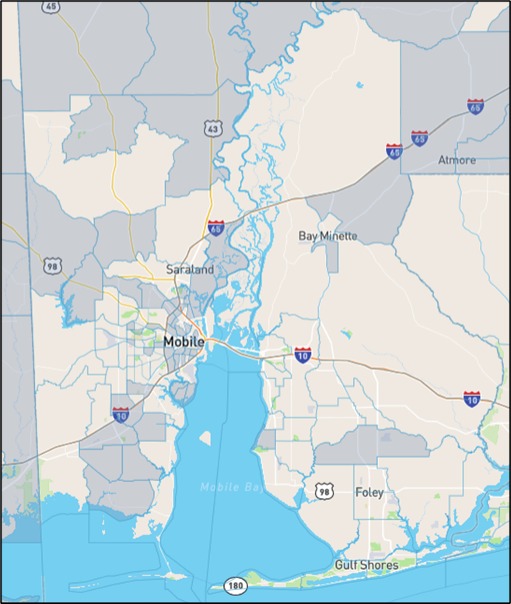
Years 1&2: TAC-4 Justice 40 Green Infrastructure Initiative $500,000
Justice 40 Green Infrastructure Program
Available to areas within Justice 40 Map (pending- Can communities make defense for areas not on the map?)
MBNEP will recruit interest from local government, public housing authorities
MBNEP will lead project development and implementation where necessary
Promotion of green infrastructure technologies in an underserved area
Opportunity to elevate environmental protection as a community growth initiative
Potential national model for incorporating EPA Environmental protection into HUD Public Housing/CDBG community development programs
Justice 40 Green Infrastructure Project Delivery at 50% FTE $87,256

Slide 11
Re-Writing the 5-Year CCMP
Role of the Finance Committee
Representation of major stakeholders across our two coastal counties
Representation of major resources supporting the program
Key group to help shape MBNEP value
How do we do this?
MOU
Multi Year Funding agreements
Increase in State Appropriation
Resource Development Plan (Partnerships, other)
Charge: Revise, Improve the Finance Strategy for the next 5-Year period

Slide 12
Is this simply a Finance Committee? Or is it…
A Resource Development Committee?
An Organizational Growth Committee?
Other?

Slide 13
Proposal: A Committee Strategic Planning Workshop
Workshop would focus on strategic development for the Finance Committee
Create MBNEP sustainability priorities (funding, partnerships, other)
Create of a 5-year Action plan
Outcome: A Resource Plan to Sustain MBNEP and Support CCMP implementation
Resources Provided: MBNEP will provide external facilitation, logistical support
Timeline: Spring, 2023
Request to Committee: What information can MBNEP compile prior to meeting to help guide discussion?

