Slide 1
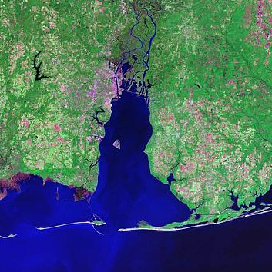
Science Advisory Committee
March 15th, 2024
In-person attendees: Please write your name and affiliation on the sign- in sheet
Virtual attendees: Please type your name and affiliation in the chat

Slide 2
Today’s Agenda
Welcome Back - SAC Co-chairs Dottie Byron and Steve Jones
Facilitation Introduction
Review and Approval of Minutes
Old Business
Stressor Evaluation: introduction of process for review – Blair Morrison, MBNEP
Updates and Presentations
Timeline of CCMP rewrite – Roberta Swann, MBNEP
SAC tasks - development of EST strategy - Dottie Byron and Steve Jones
Overview of 2018-2023 CCMP evaluation and recommendations - Blair Morrison
Discussion questions and considerations
Development of subcommittees?
Small group brainstorming, discussion, and report-out of ideas for updated SAC strategy
Announcements
Upcoming Monitoring Summit – Blair Morrison
Planning committee, revisit of the Subwatershed Monitoring Framework
Off-cycle State of the Bay Workshop – Chris Warn, Environmental Science Associates
Registration coming shortly
Adjourn

Slide 3
Welcome and Facilitation Introduction
Dottie Byron and Steve Jones

Slide 4
Stressor Evaluation: Process for Review
Blair Morrison

Slide 5
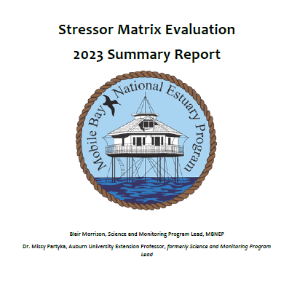
Introduction to Review Process
30-day comment period
Anonymous SurveyMonkey poll
2023 Stressor Evaluation will be emailed to SAC listserv along with link to the review form

Slide 6
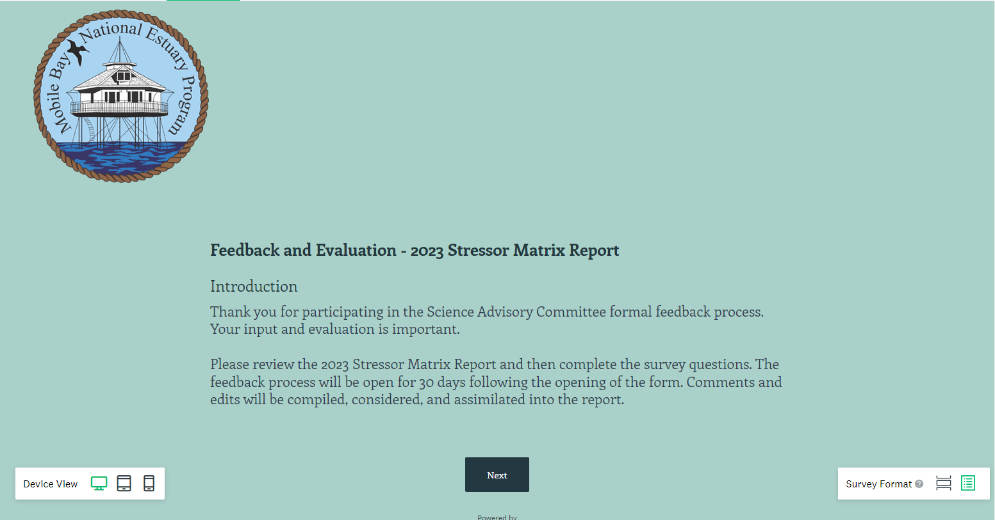

Slide 7
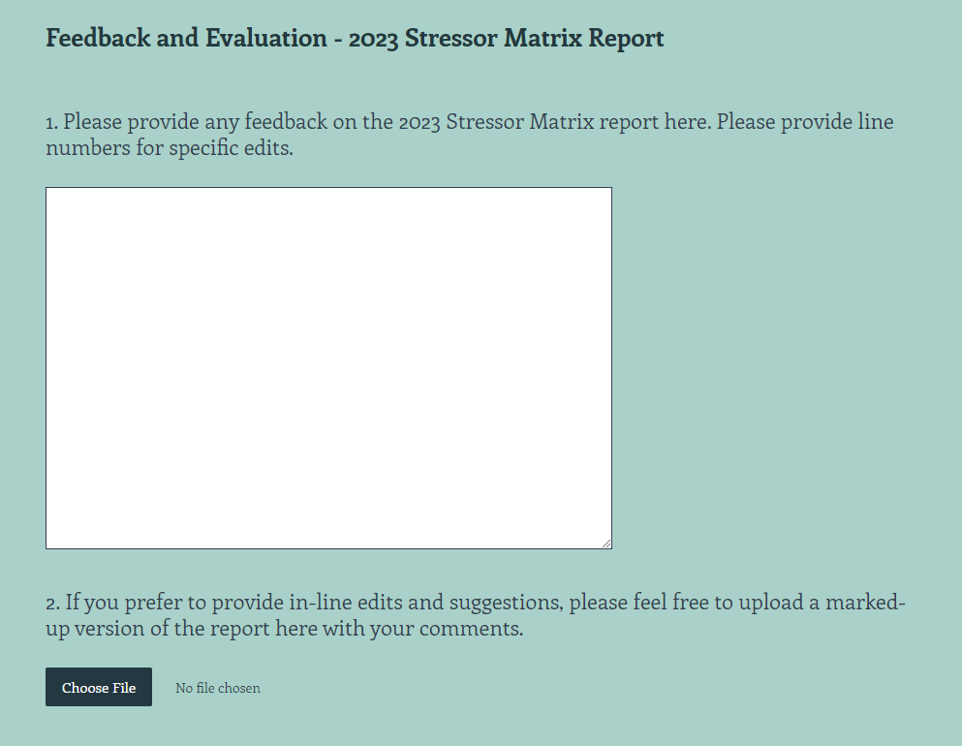

Slide 8
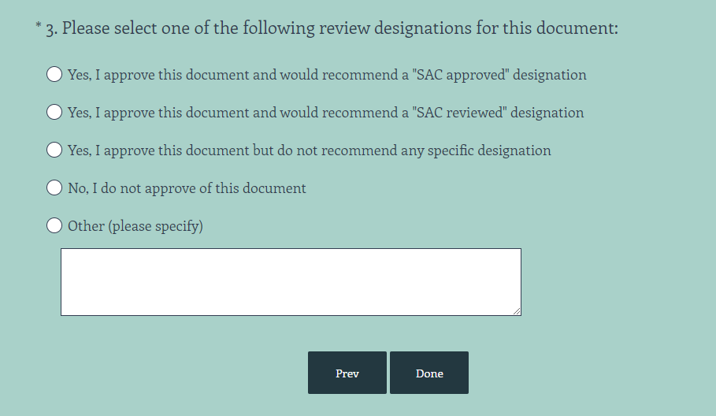

Slide 9
Timeline of CCMP Rewrite
Blair Morrison

Slide 10
Element | Completion Date | Status
Watershed Plan Assessment | 9/30/2023 | Complete
CCMP Evaluation of Implementation Technical Report | 9/30/2023 | Complete
Stressor Evaluation Technical Report | 1/31/2024 | Complete; on agenda at SAC mtg for review
Management Conference Organizational Assessment-Bylaws Update | 3/31/2024 | Complete
State of the Bays and Coast Report | 6/30/2024 | In Progress
CCMP Development-Outreach, Strategies for each committee, Financing, Publication | 6/30/2025 | In Initial Planning; this will be a mix of in-house staff effort and support from contractor
CCMP Comment Period and Approvals | 9/30/2025 | Not Initiated

Slide 11
SAC Task: EST Strategy
Dottie Byron and Steve Jones

Slide 12
The SAC is charged with creating strategies for the next CCMP
Likely will need to form subcommittees / convene off-cycle meetings to flesh out ideas and descriptions for the strategies
Potentially developing a SAC committee strategy – which includes pillars of Ecosystem Status and Trends (EST), Ecosystem Restoration and Protection (ERP), Technical Assistance and Capacity-Building (TAC), and Education and Public Involvement (EPI)

Slide 13
2018-2023 CCMP Evaluation Overview
Blair Morrison

Slide 14
2018-2023 CCMP Evaluation: Overview and Recommendations

Slide 15
EST Strategy
EST 1: Increase availability and use of data related to how coastal ecosystems and their services respond to manmade stresses
EST 2: Establish a process for measuring, analyzing, and communicating change in marine, estuarine, and freshwater ecosystem conditions
EST 3: Model and predict connections between ecosystem condition and the ecosystem services people value

Slide 16
EST 1.1: Establish a data management and usage strategy
To facilitate effective data management and use, MBNEP developed a Data Management and Usage Strategy. Through this strategy, all data generated through MBNEP activities, are to be:
Assembled with standardized metadata and uploaded to the Dauphin Island Sea Lab (DISL) repository
Identified using a unique digital object identifier (DOI), making them easily located and cited
Made accessible for viewing and download through open online access

Slide 17
EST 1.1: Recommendations
Continue to promote a consistent, widely-adopted Data Management Strategy (EST-1.1) for data generated by MBNEP projects, including pre- and post-construction monitoring and environmental data. Considerations could include:
Assemble and upload data from completed projects to the DISL data repository
Promote formal adoption of the Data Management Strategy by partners
Require all new research and monitoring to follow the strategy
Continue to task the Science Advisory Committee to lead this work

Slide 18
EST 1.2: Maintain or improve existing level of monitoring and data analysis to assess trends in coastal ecosystem health at a watershed scale.
In 2015, the MBNEP Science Advisory Committee developed a Subwatershed Restoration Monitoring Framework (MBNEP SAC 2015) consisting of protocols designed to standardize data collection for evaluating pre- and post-restoration efforts in Mobile and Baldwin Counties.
The Framework recommends standardized monitoring procedures to help determine:
Changes in water quality, flow, sedimentation, biology, and habitat quality and quantity resulting from watershed management plan implementation and restoration projects
Relationships between ecosystem health indicators and ecosystem function and services
The long-term status and trends in the watershed.
Since its development, the Monitoring Framework has been incorporated into new watershed management plans and restoration proposals and contracts, is included in all watershed planning packages for reference, and is followed in the collection of any pre- and post-restoration work funded through MBNEP sources.

Slide 19
EST 1.2: Recommendations
Upcoming opportunities!
Continue to promote, update, and adapt the Monitoring Framework (EST-1.2). Priorities could include:
Develop a data sharing/data user agreement that is mindful of both academia and resource management data considerations. Convene a SAC subcommittee to further evaluate the needs of all parties.
Continue to evaluate and refine the Framework to ensure consistency with other monitoring guidelines throughout the Gulf of Mexico, including those developed by Gulf of Mexico Alliance, The National Oceanic and Atmospheric Administration, and the Gulf of Mexico Coastal Ocean Observing System.
Continue to update older watershed management plans to follow the Monitoring Framework. MBNEP should also update the Framework, possibly with the assistance of Alabama Water Watch, to promote best practices for the collection and use of volunteer monitoring data
Update the Monitoring Framework to incorporate volunteer monitoring data.

Slide 20
EST 1.3: Promote consistent system-wide monitoring to assess trends in coastal ecosystem health
Sediment studies - D’Olive, Fowl River, Bayou La Batre, West Fowl River, and Deer River watersheds and the Dog River, Bon Secour River, Weeks Bay, Wolf Bay, Eastern Shore, and Mobile-Tensaw-Apalachee watershed complexes.
Hydrologic models - Bon Secour, Wolf Bay, Dog River, Bayou La Batre, Fowl River, West Fowl River, and Tensaw East and West watersheds, and the 12 Mile Creek sub-watershed.
ADEM maintains an extensive network of 317 environmental monitoring locations in the MBNEP study area, with 154 sites within Baldwin County and adjacent waters, 163 in Mobile County and adjacent waters, and seven in open ocean locations
Local Enterococci/ E. coli Bacterial monitoring is implemented by ADEM Beach Monitoring Program, Mobile Baykeeper, and AL Water Watch
SAV monitoring surveys have occurred in 2002, 2005, 2008–2009, and 2015.
Alabama Department of Conservation and Natural Resources Marine Resources Division (AMRD) monitors Alabama’s public oyster reefs annually using divers to count oysters along transects
MBNEP funded a groundwater quality study of the surficial aquifer discharging into Little Lagoon as part of watershed planning in the Gulf Frontal Watershed.
Volunteers actively monitor almost 100 sites in coastal Alabama, focusing on Dog River, Fowl River, Wolf Bay, Weeks Bay, Gulf Frontal, and Western Perdido Bay.
Baseline pre-restoration monitoring is ongoing for restoration projects planned for the Deer River shoreline and marsh system, Fowl River marsh spits, and incised tributaries to Lower Fish River
In 2019, post-restoration monitoring confirmed that the siltation impairment no longer existed for Joes Branch, resulting in its delisting from the State’s List of impaired waterbodies in 2020 (ADEM 2020a).
Following MBNEP’s 2016 restoration of the northern tip of Mon Louis Island, analyses of existing and acquired aerial imagery were used to assess loss or accretion of the shorelines north of the Fowl River navigation channel and shoreline areas adjacent to and south of the rock dike breakwater.
ARCOS network has expanded

Slide 21
EST 1.3: Recommendations
Continue to promote consistent system-wide monitoring to assess trends in coastal ecosystem health (EST-1.3). Considerations could include:
Data use and monitoring support: Continue to engage with local and state partners to use existing data in decision support and to commit to "trends" monitoring investments.
Habitats and sedimentation: Continue to conduct baseline and monitoring studies of habitats and sedimentation as an important component of watershed planning.
Hydrologic modeling: Continue to model hydrology in priority watersheds and calibrate hydrologic models to improve performance and capability.
Bacteria: Increase efforts to monitor Escherichia coli. The leading agency could be the Alabama Department of Public Health or FDA.
Groundwater: Continue to engage with groundwater monitoring partners in a support role to recommend groundwater data collection needs and help identify potential sources of pollutants to surface waters.
Water Quality (ADEM): Continue to engage with ADEM and Partners in a support role to recommend water quality data collection needs and provide input on monitoring protocols. Evaluate whether the three-year cycle of surface water monitoring in basins is sufficient to allow timely detection of problems and adaptive management response. Engage county support for key monitoring locations, including areas with known or emerging stressors.
Water Quality (Volunteers): Continue to support volunteer monitoring by partnering with Alabama Water Watch to provide training and technical support. Expand and integrate Alabama Water Watch’s capacity to rapidly assess emerging conditions or focus on hypothesis-driven monitoring to supplement and inform ADEM’s sampling strategy. Incorporate volunteer monitoring data into the Monitoring Framework and continue to coordinate and refine a monitoring network which mixes volunteer with State resources.
Pre- and Post-Restoration: Continue to prioritize pre- and post-restoration monitoring, especially for major restoration projects like those in the D’Olive Watershed with the goal of delisting more streams with impaired segments. Evaluate needs for post-restoration management, focusing on monitoring that can inform adaptive management of invasive species and other restoration features to ensure success.
Remote Sensing: Develop a more comprehensive remote sensing strategy.
Benthic Habitats: Continue to support seagrass and oyster monitoring.

Slide 22
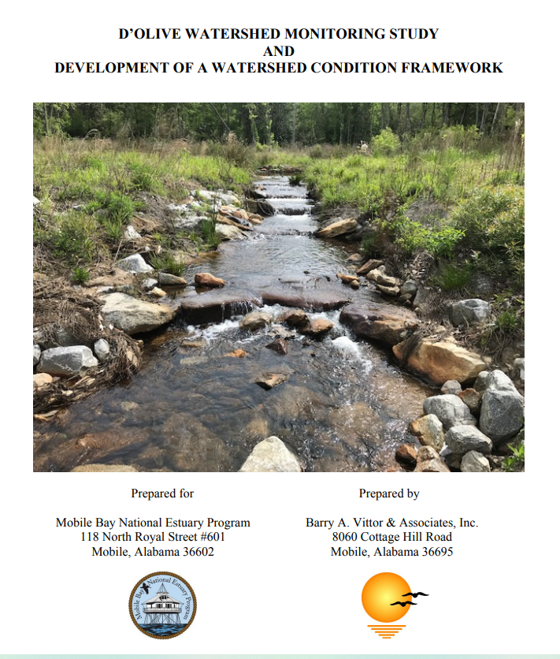
EST 2.1:Synthesize monitoring data to develop a watershed condition index to track and communicate trends in watershed restoration and management
In 2019, MBNEP led the development of a Watershed Condition Framework (WCF), using the D’Olive Watershed as a model, that could later serve as a template for other watersheds (MBNEP 2020). The WCF is based on using a Biological Condition Gradient (BCG) to describe the biological condition of habitats along a continuum of stress.
Geological Survey of Alabama sediment load monitoring
Cities of Daphne and Spanish Fort water quality data (conductivity, temperature, pressure/depth, and dissolved oxygen)
ADEM/USGS water quality data (flow, conductivity, temperature, pressure/depth, and dissolved oxygen)
DISL monitoring in D'Olive Bay (TSS, chlorophyll a, CDOM, DO, temperature, and salinity)
Riparian Buffers - Habitat Health Level Evaluation
Wetlands – Wetland Rapid Assessment Procedure
Streams – Rapid Stream Assessment (including ADEM Habitat Assessment and Riparian Habitat Health Level Evaluation).

Slide 23
EST 2.1: Recommendations
Improving the process for measuring, analyzing, and communicating change in marine, estuarine, and freshwater ecosystem conditions (EST-2) should remain a focus. Considerations could include:
Continue to calibrate and improve the performance of the Watershed Condition Framework to measure benefits of restoration.
Utilize the Watershed Condition Framework in additional watersheds under watershed management plan implementation.
Utilize the Watershed Condition Framework to help develop State of the Bay reports every five years.

Slide 24
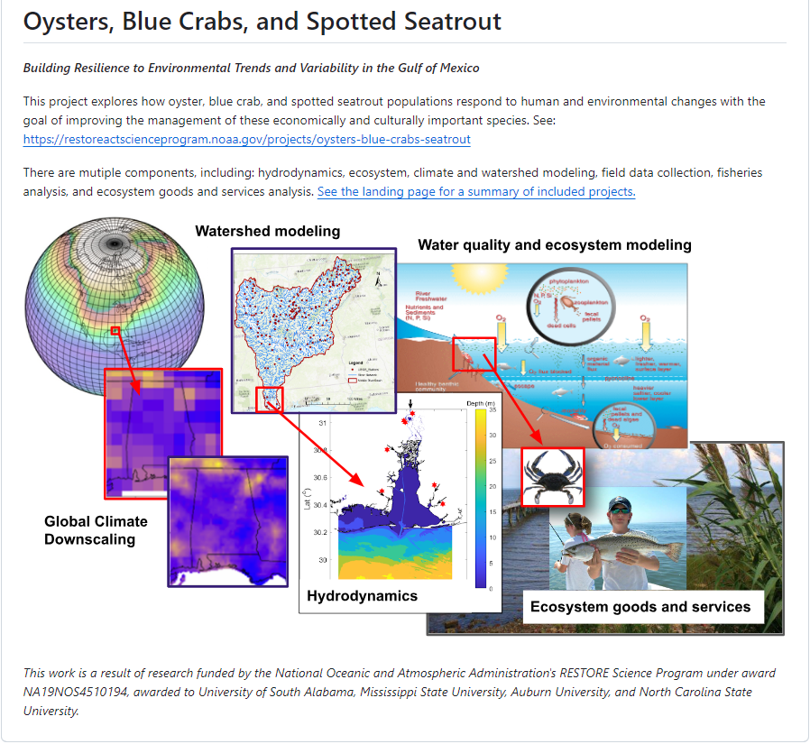
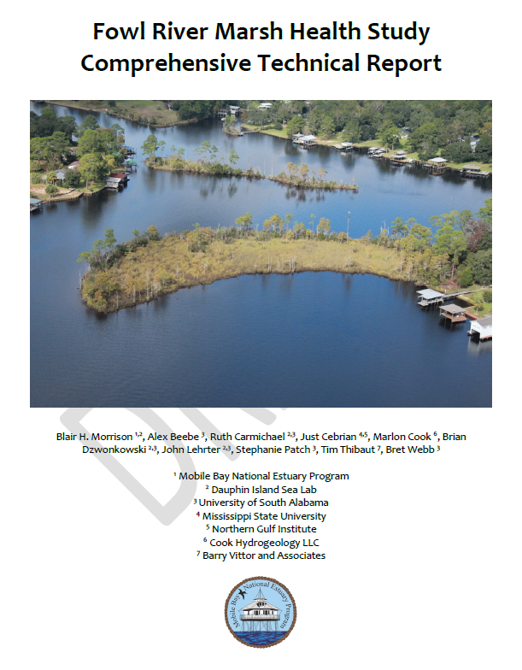
EST 3.1: Manage system for multiple services
Maintaining connection between the things most valued by people living on Alabama’s coast and actions to protect and restore waterbodies and watersheds is key to generating and sustaining public support.
The MBNEP Science Advisory Committee has developed a Stressor Matrix that determines perceptions on what stressors are having the most impact throughout the Mobile Bay estuarine system The Matrix is intended to be used as a rapid decision-making tool to quantify stressors, inform water quality and habitat protection and restoration strategies, and elucidate appropriate estuarine indicators to determine relationships between hydrologic, hydrodynamic, sedimentological, and biological processes.
Planning for climate impacts to coastal Alabama is underway by MBNEP and partners:
Alabama Coastal Comprehensive Plan
SLAMM and SLOSH models incorporated in Watershed Management Plans
Decadal Study
Fowl River Marsh Study
West Fowl River System Study

Slide 25
EST 3.1: Recommendations
Modeling and predicting connections between ecosystem condition and the ecosystem services people value (EST-3) should remain an important goal over the next ten years. Considerations could include:
Continue to quantify impacts of anthropogenic and climate stressors on ecosystem health and services as well as the economic importance of protecting and restoring water and habitat quality for the things people value most about living in coastal Alabama.
Promote hypothesis-driven monitoring to better understand connections between ecosystem condition and services.

Slide 26
Let’s Discuss!

Slide 27
Breakout Session: Discussion of EST Strategies
40 minutes

Slide 28
Breakout Session Instructions
In person attendees - will split into groups with easel paper
Virtual attendees – will join a breakout room with a jamboard
Discussion Questions: ~40 minutes
For each EST Strategy: 10 minutes each
Pros? Cons?
Feasibility?
Are we still committed to this as an EST strategy?
What is missing? : 10 minutes
Report-out from all groups : ~20 minutes
Each group should designate a reporter during discussion

Slide 29
Virtual Jamboard for Breakout Rooms
Click arrows to advance to new EST strategy note sheet
Add post-it notes
Add text boxes

Slide 30
Report-out from Small Groups
20 minutes

Slide 31
Announcements
Upcoming Monitoring Summit :
Revisiting and updating the 2015 Monitoring Framework
Planning Committee – reach out if interested!
Likely held in the next few months
Off-cycle State of the Bay Workshop :
Registration coming soon!

Slide 32
Thank You For Attending!

