Slide 1
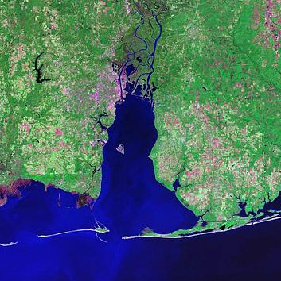
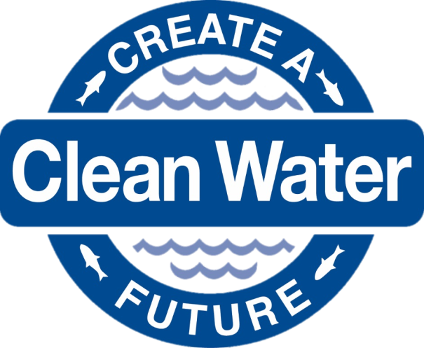
Science Advisory Committee
September 20th, 2024
In-person attendees: Please write your name and affiliation on the sign- in sheet
Virtual attendees: Please type your name and affiliation in the chat

Slide 2
Today’s Agenda
Welcome Back and Introductions
Review and Approval of Minutes
Facilitation Notes and Meeting Products
Old Business
Stressor Evaluation accepted
Updates and Presentations
Cross-Committee Updates
Roundtable CCMP Survey discussion
Prep for October 24th Management Conference Meeting
Overview of committees
Overview of issues
Overview of inter-committee support
Announcements
Adjourn

Slide 3
Welcome and Introductions
Steve Jones

Slide 4
Review and Approval of Minutes
Steve Jones

Slide 5
Facilitation Notes and Meeting Products
Dottie Byron

Slide 6
Zoom Whiteboard for Discussion Notes
Add text boxes
Add post-it notes
Virtual attendees:
add notes directly to board; raise hand on Zoom before unmuting to discuss
In-person attendees:
raise hand to discuss; note will be transcribed and added to the board

Slide 7
Meeting Products
A list of brainstormed project ideas to bring to the October management conference meeting
A tentative list of SAC asks / contributions for the management conference

Slide 8
Old Business: Stressor Evaluation
Blair Morrison

Slide 9
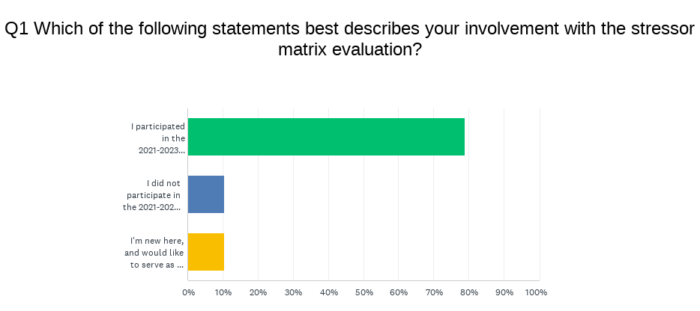
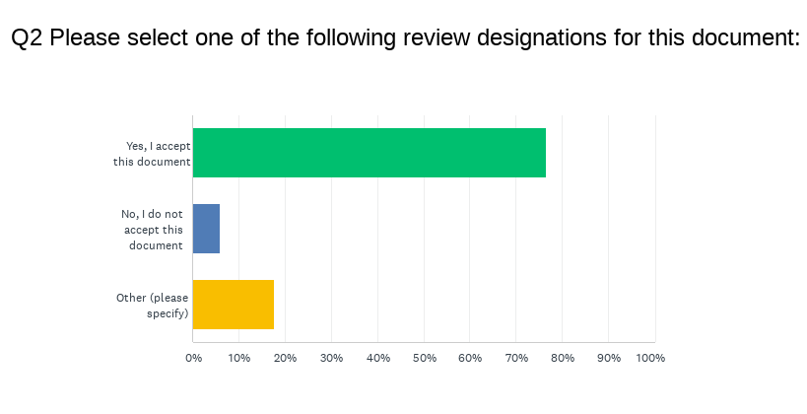
Stressor Matrix Report Accepted
19 responses total
15/19 participated in the 2021-2023 Stressor Matrix
2 external reviewers – thank you!
17/19 assigned a review designation (Q2)
50:50 split on language:
SAC approved
SAC reviewed

Slide 10
Cross-Committee Updates
Blair Morrison

Slide 11
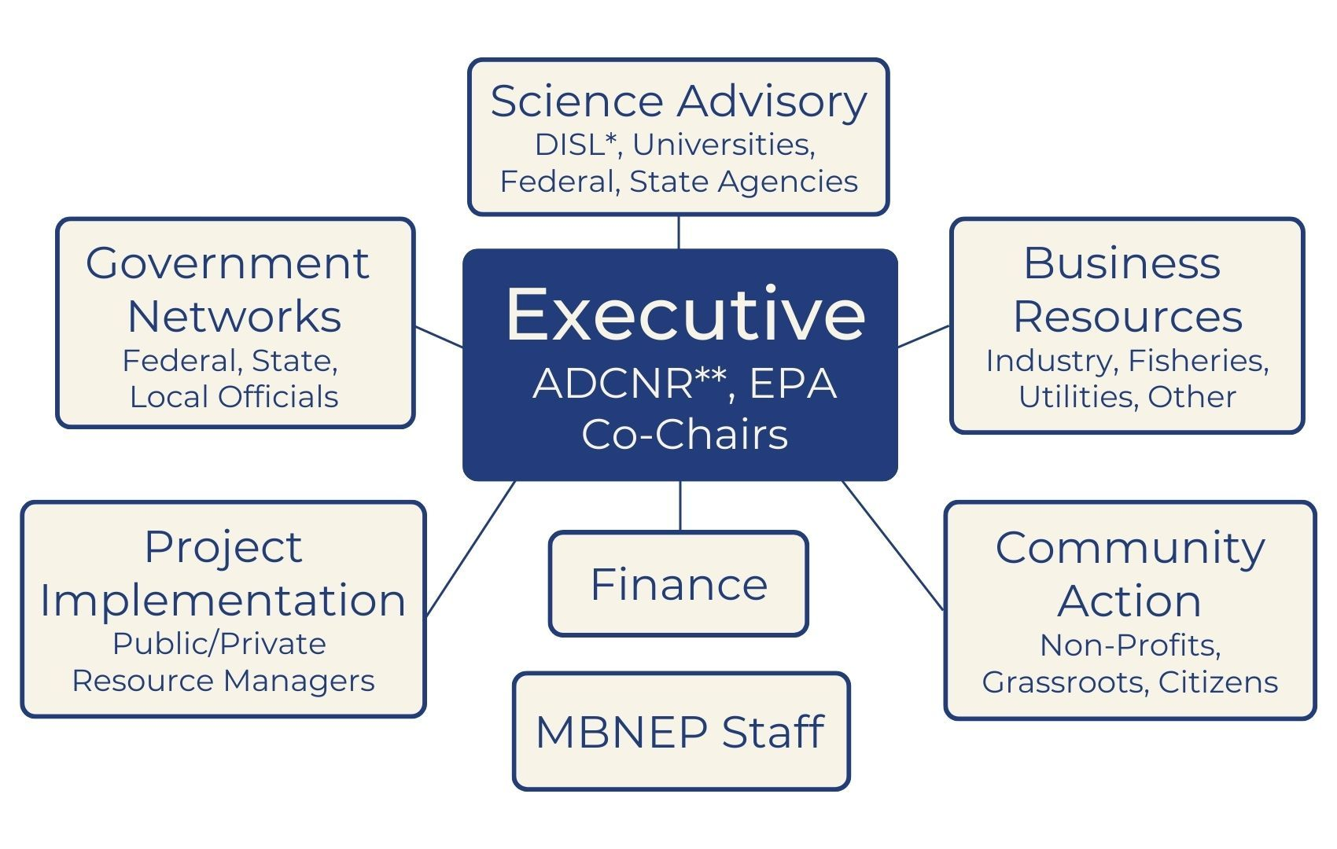
Stressor Matrix Report consensus, CCMP SAC Action Planning, listserv, membership guidelines, outcomes from Monitoring Summit and State of the Bay workshop
Stressor Matrix Report results, Presentation on hurricane season outlook from NWS-Mobile, CCMP GNC Action Planning, upcoming presentation from USACE
Christensen Global Strategies Report on expanding green and blue business in the Mobile region (includes industry leader interviews, asset assessment, funding opportunities, and project recommendations), CCMP BRC Action Planning
Stressor Matrix Report results, CCMP PIC Action Planning, Reviewed Watershed Plan Project Status, NEPORT Data Collection, Watershed Management Plan Project Map
Presentations on Wastewater Source-Tracking Canine Program, Effectively Communicating Climate Change, CCMP CAC Action Planning, and Watershed Management Plan Project Map
Workplan Approval

Slide 12
CCMP Survey and Discussion
Dottie Byron, Steve Jones,
and Blair Morrison

Slide 13
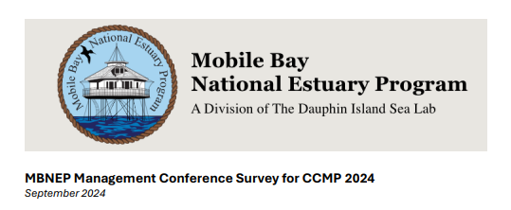
What is the CCMP Survey?

Slide 14
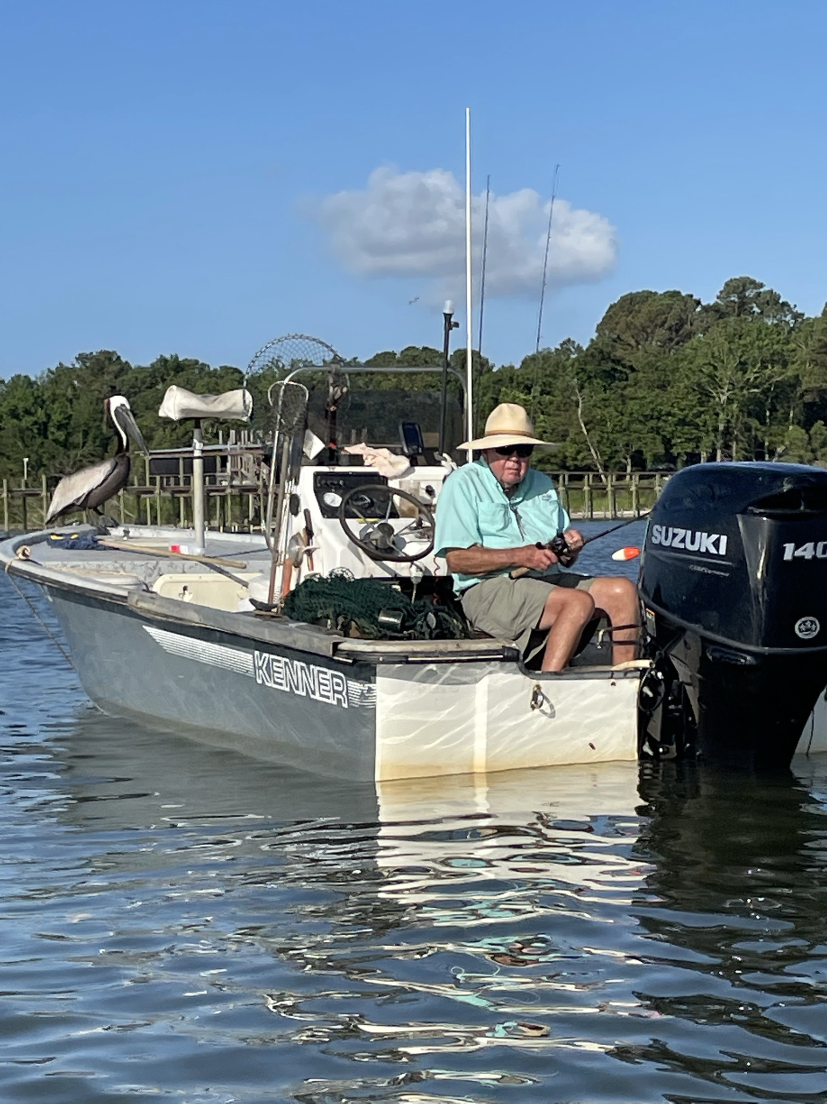
The New CCMP: A Compilation of Action Plans
Committee Action Plan Framework
Estuary Status/Trends Measures
What are you planning to improve and how will progress be measured? (think objectives here)
Restoration/Protection Actions/Projects
What actions or initiatives will committee take to achieve it? Who will lead/participate?
TA/Capacity Building Advancing knowledge
How will you advance the knowledge of your committee or sector through your work?
Ed/Public Involvement Communicating Results
How will you communicate your committee’s work to the public and conference?
Notes:
[ROBERTA]

Slide 15
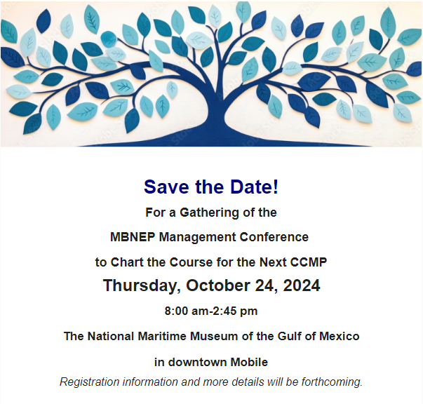
Why are we doing it?

Slide 16
Sediment Management
Waste Management
Community Growth Management
Coordinate long-term sediment monitoring to measure changes in sediment elevation and transport over time to provide a comprehensive view of sediment dynamics for improved management of headwater and coastal environments. | 10
Expand best management practices to minimize erosion and sedimentation including protection and restoration of streambank buffers, expansion of best practices for agriculture and forestry, installation of instream stormwater facilities reintroducing ecological function, and incentivizing new ways of using excess sediment. | 9
Conserve natural habitats across the coastal landscape by promoting conservation easements, acquisition, and other methods for habitat protection. | 6
Improve dredge management practices through the expansion of beneficial use to minimize sediment disruption and habitat degradation to support biodiversity and ecosystem functions. | 6
Expand Living Shorelines by adapting hardened structures with vegetated areas, stabilizing shorelines, reducing wave impact, enhancing habitat quality, and mimicking natural sediment transport. | 7
Reimagine how sites are developed to maximize natural areas and minimize environmental impacts to encourage infiltration of stormwater, reducing runoff and recharging aquifers. | 9
Engage watershed communities in conservation and sustainability efforts through education, support for local regulatory improvements, and volunteer actions including baseline water quality monitoring. | 9
Coordinate long-term waste monitoring and access to data related to sanitary sewer overflows and fish consumption advisories to measure trends in bacteria and nutrient loads, and debris for improved management of coastal environments. | 11
Reduce Harmful Contaminants like bacteria, viruses, and pollutants by improving wastewater and stormwater treatment, including septic systems, agricultural runoff, pet waste, industrial discharges, and other contamination sources. | 10
Reduce Nutrient Pollution by implementing measures to minimize excess nutrients from fertilizer use, yard waste, and pet waste in wastewater and stormwater and incentivizing new ways of capturing nutrients from the environment. This helps prevent harmful algal blooms, oxygen depletion, and fish kills, improving aquatic ecosystem health. | 11
Manage Marine Debris by reducing litter, especially single-use plastics, to protect wildlife from ingestion and entanglement. Limit plastic waste to prevent microplastic pollution and protect marine life and the food chain. | 9
Enhance commercial and industrial Waste Management by implementing stronger waste management practices, more effective regulations, and upgrading infrastructure to mitigate environmental and public health risks. | 4
Engage watershed communities in citizen science, community clean ups and awareness campaigns to spread the word. | 6
Coordinate long-term environmental monitoring to measure trends in land use/land cover change, sea level rise, and water quality and quantity in coastal watersheds for improved management of coastal environments. | 12
Expand Habitat Management and Conservation to protect and improve management of forests, farmlands, freshwater wetlands, coastal marshes, shorelines and dune systems. | 7
Advance Stormwater Management through incorporation of green infrastructure and Low Impact Development (LID) into land use and development plans, supported by regulatory improvements, best practices, and incentives to manage stormwater volume and velocity. | 7
Improve Land Use Planning to implement policies for balanced growth, reducing sprawl, and preserving natural areas. | 7
Expand Climate Change Adaptation/Preparedness by reinforcing shorelines, elevating structures, and updating building codes to address sea-level rise and stronger storms. Strengthen emergency systems and public awareness for hurricanes and flooding. | 6
Engage watershed communities in conservation and sustainability efforts through education, support for local regulatory improvements, and access to green spaces. | 6

Slide 17
In 2023 polling, the Management Conference was unified in its position that the MBNEP be an unbiased provider of science for emerging/controversial issues impacting the CCMP. Specifically, how do you see the MBNEP best playing that role? (Choose all that apply)
Would you be interested and willing to share knowledge/expertise with other committees of the Management Conference related to the above focus areas? (Choose all that apply)
Yes, through webinars | 8
Yes, through newsletter blurbs | 3
Yes, through designated time in committee meetings as a report-out | 7
Yes, submit presentations to the Committee agenda for consideration | 6
No | 3
A formal source of information (functions as subject matter experts, provides peer-reviewed literature, etc.) | 11
Providing forums for presenting the latest science/technology on the issue | 13
Developing consensus of the committee and signing on to letters of support/opposition | 6

Slide 18
Sediment Management is crucial for maintaining the health and resilience of Alabama's shorelines, coastal habitats, and water quality. Effective land management, through the implementation of best management practices, erosion control, stormwater management and regulatory improvements addresses the sediment challenges posed by land use changes, such as urbanization and deforestation, which exacerbate erosion and sedimentation issues. These activities, combined with the impacts of climate change, lead to increased runoff and sediment transport, often carrying pollutants that harm aquatic ecosystems. Shoreline erosion and sediment imbalance, where sediment is either excessively accumulated or inadequately supplied, can degrade coastal habitats and reduce biodiversity. Strategic sediment management is essential for protecting and enhancing Alabama's coastal environments.
Coordinate long-term sediment monitoring to measure changes in sediment elevation and transport over time to provide a comprehensive view of sediment dynamics for improved management of headwater and coastal environments.
Expand best management practices to minimize erosion and sedimentation including protection and restoration of streambank buffers, expansion of best practices for agriculture and forestry, installation of instream stormwater facilities reintroducing ecological function, and incentivizing new ways of using excess sediment.
Conserve natural habitats across the coastal landscape by promoting conservation easements, acquisition, and other methods for habitat protection.
Improve dredge management practices through the expansion of beneficial use to minimize sediment disruption and habitat degradation to support biodiversity and ecosystem functions.
Expand Living Shorelines by adapting hardened structures with vegetated areas, stabilizing shorelines, reducing wave impact, enhancing habitat quality, and mimicking natural sediment transport.
Reimagine how sites are developed to maximize natural areas and minimize environmental impacts to encourage infiltration of stormwater, reducing runoff and recharging aquifers.
Engage watershed communities in conservation and sustainability efforts through education, support for local regulatory improvements, and volunteer actions including baseline water quality monitoring.
Example for SAC

Slide 19
Waste Management. Coastal Alabama's habitats and water quality face severe threats from anthropogenic waste. Aging wastewater infrastructure leaks untreated sewage into rivers and coastal waters, causing nutrient pollution, harmful algal blooms, and fish kills, jeopardizing aquatic ecosystems and human health. Litter, particularly single-use plastics, exacerbates the problem by accumulating in waterways, harming wildlife, and breaking down into microplastics. This waste also stresses stormwater infrastructure, increasing flood risks and weakening community resilience. Additionally, inadequate management of commercial and industrial waste further compounds these issues.
Coordinate long-term waste monitoring and access to data related to sanitary sewer overflows and fish consumption advisories to measure trends in bacteria and nutrient loads, and debris for improved management of coastal environments.
Reduce Harmful Contaminants like bacteria, viruses, and pollutants by improving wastewater and stormwater treatment, including septic systems, agricultural runoff, pet waste, industrial discharges, and other contamination sources.
Reduce Nutrient Pollution by implementing measures to minimize excess nutrients from fertilizer use, yard waste, and pet waste in wastewater and stormwater and incentivizing new ways of capturing nutrients from the environment. This helps prevent harmful algal blooms, oxygen depletion, and fish kills, improving aquatic ecosystem health.
Manage Marine Debris by reducing litter, especially single-use plastics, to protect wildlife from ingestion and entanglement. Limit plastic waste to prevent microplastic pollution and protect marine life and the food chain.
Enhance commercial and industrial Waste Management by implementing stronger waste management practices, more effective regulations, and upgrading infrastructure to mitigate environmental and public health risks.
Engage watershed communities in citizen science, community clean ups and awareness campaigns to spread the word.
Example for SAC

Slide 20
Community Growth Management. Coastal Alabama's rapid urbanization presents challenges like increased stormwater runoff, habitat loss, and ecosystem degradation. Climate change worsens these issues with rising sea levels and more frequent extreme weather events, threatening infrastructure and communities. Balancing growth with environmental protection strengthens community resilience by reducing climate vulnerabilities while preserving the region's heritage, culture, and sense of place. Sustainable practices like freshwater wetland protection and restoration, green infrastructure and habitat preservation manage stormwater, prevent flooding, and buffer extreme weather, all while enhancing ecosystems, supporting local economies, and maintaining the unique cultural identity that defines Coastal Alabama.
Coordinate long-term environmental monitoring to measure trends in land use/land cover change, sea level rise, and water quality and quantity in coastal watersheds for improved management of coastal environments.
Expand Habitat Management and Conservation to protect and improve management of forests, farmlands, freshwater wetlands, coastal marshes, shorelines and dune systems.
Advance Stormwater Management through incorporation of green infrastructure and Low Impact Development (LID) into land use and development plans, supported by regulatory improvements, best practices, and incentives to manage stormwater volume and velocity.
Improve Land Use Planning to implement policies for balanced growth, reducing sprawl, and preserving natural areas.
Expand Climate Change Adaptation/Preparedness by reinforcing shorelines, elevating structures, and updating building codes to address sea-level rise and stronger storms. Strengthen emergency systems and public awareness for hurricanes and flooding.
Engage watershed communities in conservation and sustainability efforts through education, support for local regulatory improvements, and access to green spaces.
Example for SAC

Slide 21
Discussion Session Instructions
Virtual attendees: add notes directly to board; raise hand on Zoom before unmuting to discuss
In-person attendees: raise hand to discuss; note will be transcribed and added to the board
Questions:
For Sediment, Waste, and Community Growth Management:
What projects could the SAC do to address this concern in coastal Alabama? What can the SAC provide to other committees in addressing this issue? What does the SAC need from other committees in addressing this issue?

Slide 22
Next Steps and Logistics

Slide 23
Science Advisory Committee CCMP Strategy:
Changing Landscapes, Changing Climate
Sediment Management
EST: Measure/Monitor
ERP: Actions/Projects
TAC: Advancing Knowledge
EPI: Communicating Results
Waste Management
EST: Measure/Monitor
ERP: Actions/Projects
TAC: Advancing Knowledge
EPI: Communicating Results
Community Growth Management
EST: Measure/Monitor
ERP: Actions/Projects
TAC: Advancing Knowledge
EPI: Communicating Results

Slide 24
Creating a Google Group?
Streamlines emails
Can ask questions/ chat with team members asynchronously

Slide 25
Announcements

Slide 26
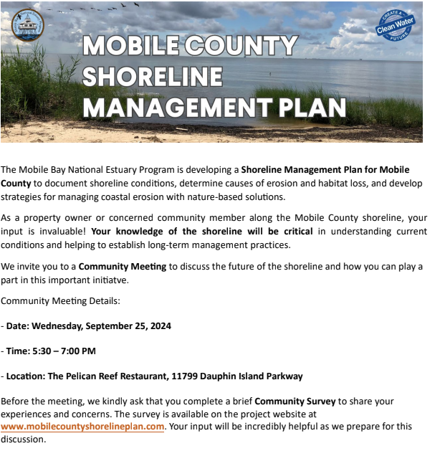
Western Shore Community Survey

Slide 27
Thank You For Attending!

